Slide 1
Basho Technologies
KNOW YOUR PLACE IN THE FOOD CHAIN

Slide 3
Basho Fox or Hedgehog?

Slide 4

Appraising the Competition
Basho:
An assiduous hedgehog.

Slide 5
Riak is the ? Database
Notes:
Quick poll: how would you complete this statement?

Slide 6
Riak is the Ops-Friendly Database
Notes:
Not everyone agrees with this, but.

Slide 8

Appraising the Competition
Notes:
Couple years ago, Erlang Factory in London, Steve Vinoski just joined
Attended a couple of presentations
Message: right tool for the job
If we don’t fit your use-case, we’ll tell you that
NoSQL toaster

Slide 9
Riak is the Ops-Friendly Database

Slide 10
Riak
MySQL
PostgreSQL
SQLServer
Oracle
MongoDB
Cassandra
CouchDB
Redis
Neo4J
VoltDB
FoundationDB
RethinkDB
RiakCS
S3
Swift
Scality
Ceph
Lustre
GlusterFS
Notes:
TE’s are there to get you technical comparisons assumption is, that if you have a strong enough conceptual framework to identify the client’s problem
Then you won’t get kicked out of a room for not knowing how Cassandra’s MDC Repl benchmarks against ours
That said, let’s party

Slide 11
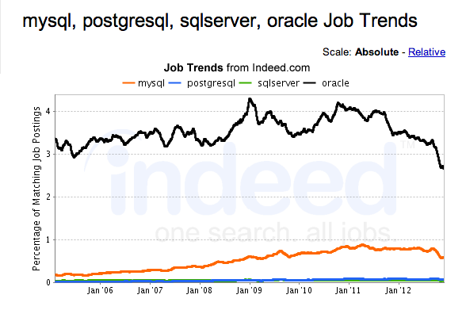

Slide 12
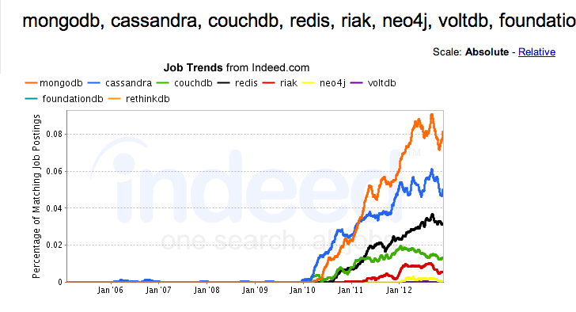

Slide 13
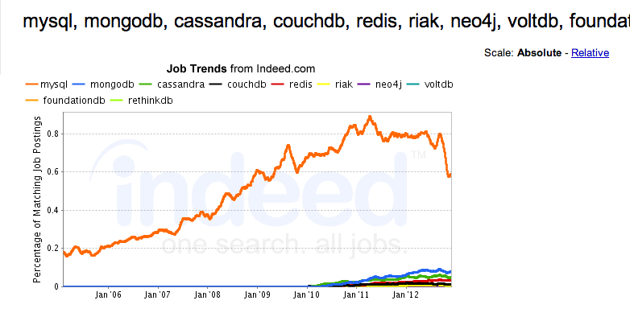

Slide 15
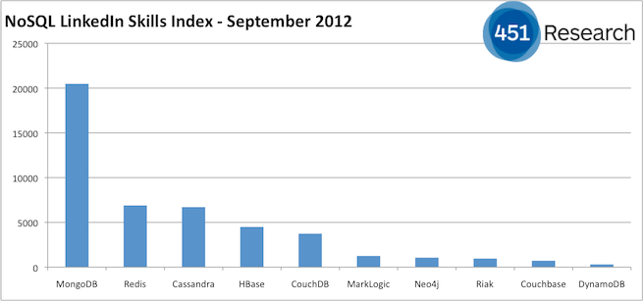

Slide 16
Riak
MySQL
PostgreSQL
SQLServer
Oracle
MongoDB
Cassandra
CouchDB
Redis
Neo4J
VoltDB
FoundationDB
RethinkDB
Notes:
Open for tech questions

Slide 18
Riak is the Ops-Friendly Database

Slide 20
RiakCS is the Private S3

Slide 21
RiakCS
S3
Swift
Scality
Ceph
Lustre
GlusterFS
Notes:
Open for tech questions

Slide 22
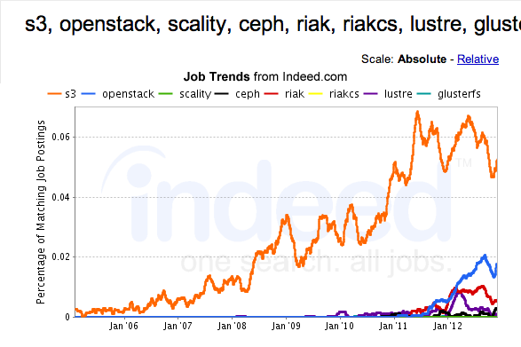

Slide 24
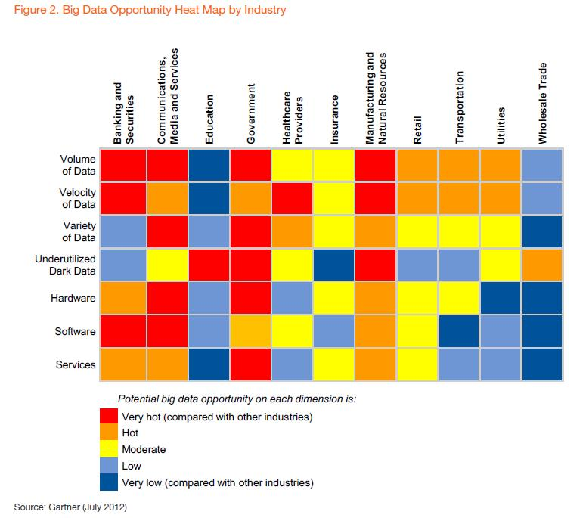

Slide 26
RiakCS is the Private S3

Slide 27
Appraising the Competition
Basho
An assiduous hedgehog.

